Slide 1
Unit 2: Mental health assessment
Causes of mental illness

Slide 2
1. Biological factors
Genetic / Hereditary. Genetic / Hereditary. Mental illnesses sometimes run in families, suggesting that people who have a family member with a mental illness may be somewhat more likely to develop one themselves. Susceptibility is passed on in families through genes. Person inherits a susceptibility to a mental illness but doesn't necessarily develop the illness.
Genetic risk of schizophrenia
Identical twin affected – 50%
Fraternal twin affected – 15%
Brother or sister affected – 10%
One parent affected – 15%
Both parents affected – 35%
Second degree relative affective – 2-3%
General population – 1%
(No affected relative)

Slide 3
Neurochemicals: Neurotransmitters and hormones
Abnormal levels of dopamine activity have been correlated with a number of disorders (e.g., reduced in ADHD and OCD, and increased in schizophrenia). Dysfunction in serotonin and other monoamine neurotransmitters (e.g., norepinephrine and dopamine), and their associated neural networks, are also moderately correlated with certain mental disorders, including major depression, obsessive compulsive disorder, phobias, posttraumatic stress disorder, and generalized anxiety disorder.

Slide 4
Infections/ toxins: Certain infections have been linked to brain damage and the development of mental illness or the worsening of its symptoms. Exposure to toxins, such as lead, may also play a role in the development of mental illnesses. Research shows that infections and exposure to toxins such as HIV and streptococcus cause dementia and OCD respectively.

Slide 5
Brain injury or defects: Defects in or injury to certain areas of the brain have also been linked to some mental illnesses.
Prenatal damage: Some evidence suggests that a disruption of early fetal brain development or trauma that occurs at the time of birth -- for example, loss of oxygen to the brain -- may be a factor in the development of certain conditions, such as autism spectrum disorder.
Substance abuse: Long-term substance abuse, in particular, has been linked to anxiety, depression, and paranoia.

Slide 6
2. Psychosocial factors
Life events and environmental stress
Severe psychological trauma suffered as a child, such as emotional, physical, or sexual abuse
An important early loss, such as the loss of a parent
Neglect
A dysfunctional family life, divorce
Changing jobs or schools
Social or cultural expectations (For example, a society that associates beauty with thinness can be a factor in the development of eating disorders.)
Substance abuse by the person or the person's parents
Poverty

Slide 7
Personality factors
Self esteem
Psychodynamic factors

Slide 8
Factors causing mental illness
1. Predisposing factors: These are factors, many of them operating from early life, that determine a person’s vulnerability to causes acting close to the time of the illness. They include genetic factors and the environment in utero, as well as physical, psychological and social factors in infancy and early childhood.

Slide 9
2. Precipitating factors: These are events that occur shortly before the onset of a disorder and appear to have induced it. They may be physical, psychological or social. Whether they produce a disorder at all, and what kind of disorder at all, depends partly on constitutional factors in the patient.

Slide 10
3. Perpetuating (maintaining) factors: These factors prolong the course of the disorder after it has been provoked. For example, in their early stages many psychiatric disorders lead to secondary demoralization and withdrawal from social activities, which in turn help to prolong the original disorder. It is often appropriate to treat these secondary factors, whether or not any other specific measures are carried out.

Slide 11
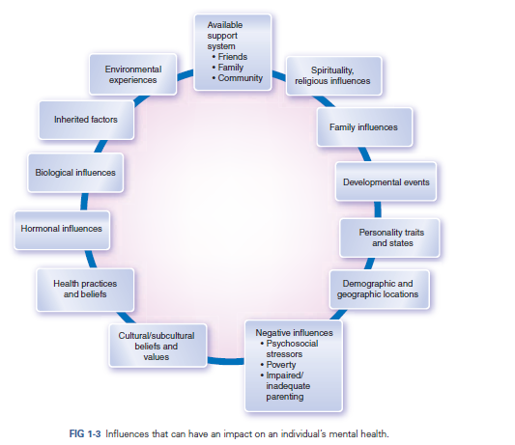

Slide 12
Classification of mental illness
Organic and functional
Psychosis and neurosis
ICD 10 and DSM 5

Slide 13
ICD
The International Classification of Diseases (ICD) is produced by the World Health Organization (WHO) as an aid to the collection of international statistics about disease.
The current version is the 10th edition (ICD- 10).Of the 21 chapters, Chapter V is devoted to psychiatry. Mental disorders were included for the first time in 1948, in the sixth revision (ICD- 6).

Slide 14
It contains descriptions of each of the disorders, and the diagnostic instructions for users make it clear that these allow some latitude for clinical judgement.
All of the diagnostic codes start with the letter F and, like the other chapters, it has 10 major divisions each of which can be divided into 10 subdivisions and so on. For example, F20, schizophrenia, can be followed by a further number for the category within group (e.g. F20.1, hebephrenic schizophrenia), and a fourth character if it is necessary to subdivide further.

Slide 15
The main categories of ICD-10 Chapter V (F)
F00 Organic, including symptomatic, mental disorders
F10 Mental and behavioural disorders due to psychoactive substance use
F20 Schizophrenia, schizotypal, and delusional disorders
F30 Mood (affective) disorders
F40 Neurotic, stress- related, and somatoform disorders
F50 Behavioural syndromes associated with physiological disturbances and physical factors
F60 Disorders of adult personality and behaviour
F70 Mental retardation
F80 Disorders of psychological development
F90 Behavioural and emotional disorders with onset usually occurring in childhood or adolescence

Slide 16
DSM
In 1952 the American Psychiatric Association (APA) published the first edition of the Diagnostic and Statistical Manual (DSM- I),
A multiaxial classification was adopted from DSM III, with five axes
(Axis I consisted of mental health and substance use disorders (SUDs); Axis II was reserved for personality disorders and mental retardation; Axis III was used for coding general medical conditions; Axis IV was to note psychosocial and environmental problems (e.g., housing, employment); and Axis V was an assessment of overall functioning known as the GAF (Global Assessment of Functioning).
Currently DSM 5: No multiaxial classification

Slide 17
Diagnostic Procedure
Electroencephalography (EEG) is an electrophysiological monitoring method to record electrical activity of the brain. It is typically noninvasive, with the electrodes placed along the scalp, although invasive electrodes are sometimes used in specific applications.
Electrodes are attached with a conductive paste.
Standard EEG consists of 21 electrodes.
Indication
Seizures,
During ECT
dementia,
pseudoseizures vs. seizures,
episodic abnormal behaviour.

Slide 18
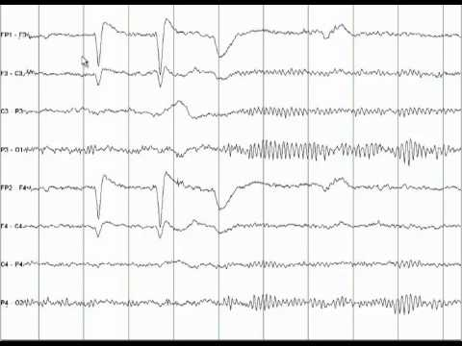
Normal EEG

Slide 19
Preparation for EEG
Wash hair the night before the EEG, and don’t put any products (such as sprays or gels) in hair on the day of the test.
Some antiepileptic drug should be stopped taking before the test.
Avoid consuming any food or drinks containing caffeine for at least eight hours prior to the test.

Slide 20
Magnetic Resonance Imaging (MRI) Scan:
for Dementia
Can not be used for patient with pace maker or implant of ferromagnetic metals
Involves inclosing the patient in a narrow tube, in which the patient must remain still for up to 20 minutes
Patient with claustrophobia can not tolerate this and may require open MRI, which is less effective
Higher resolution than CT scan.

Slide 21
Computed Tomography (CT) Scan:
Dementia
Normal pressure hydrocephalus- a treatable cause of dementia
Space occupying lesions, subdural hematoma can result cognitive deficit , Neurosyphilis,
HIV dementia- decreased brain volume.
delirium,
seizures,
first episode psychosis.

Slide 22
Psychological Testing
A psychological test is an instrument designed to measure unobserved constructs, also known as latent variables.
Objective Tests
These are pen-and-paper objective tests, which are
employed to test the various aspects of personality and
intelligence in a person.
Objective personality tests: Some examples of objective
personality tests are MMPI (Minnesota multiple personality inventory) and 16-PF (16 personality factors).

Slide 23
Intelligence tests: Some commonly used tests of intelligence are WAIS (Wechsler adult intelligence scale), Stanford-Binet test and Bhatia’s battery of intelligence tests.

Slide 24
Rating Scales
Several rating scales are used in psychiatry to quantify the psychopathology observed. Some of the commonly used scales are:
BPRS (Brief psychiatric rating scale),
SANS (Scale for assessment of negative symptoms),
SAPS (Scale for assessment of positive symptoms),
HARS (Hamilton’s anxiety rating scale),
HDRS (Hamilton’s depression rating scale),
and Y-BOCS (Yale-Brown obsessive-compulsive scale).

Slide 25
Projective Tests
In projective tests, ambiguous stimuli are used which are not clear to the person immediately. Some commonly used projective tests of personality are
Rorschach inkblot test,
TAT (Thematic apperception test),
DAPT (Draw-a person test),
and sentence completion test (SCT).

Slide 26
The Rorschach Inkblot
Test is a projective psychological test consisting of 10 inkblots printed on cards (five in black and white, five in color) created in 1921 with the publication of Psychodiagnostik by Hermann Rorschach.
During the 1940s and 1950s, the test was synonymous with clinical psychology.
Throughout much of the 20th century, the Rorschach inkblot test was a commonly used and interpreted psychological test.

Slide 27
Despite its widespread use, it has also been the center of much controversy.
It has often proven to be difficult for researchers to study the test and its results in any systematic manner, and the use of multiple kinds of scoring systems for the responses given to each inkblot has led to some confusion.

Slide 28
It consists of 10 cards
5 are black and white and 5 are multi-coloured
The cards are unstructured and do not have specific meaning.

Slide 29
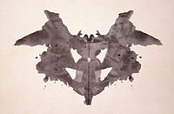

Slide 30
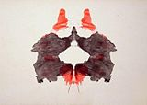

Slide 31
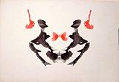

Slide 32
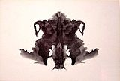

Slide 33
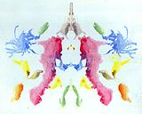

Slide 34
Administration of test
Make the patient to sit comfortable, the psychologist asks to tell what he/she sees in the card.
The psychologists notes the time taken for the response and other behaviour during test.
After all cards have been presented, second phase of enquiry follows: perception, seeks clarification and addition to original response.
Subjects’ response based on shading, movements, symbols etc. has been interpreted.

Slide 35
Thematic Apperception Test
Murray and Morgan developed this test
The Thematic Apperception Test, or TAT, is a projective measure intended to evaluate a person's patterns of thought, attitudes, observational capacity, and emotional responses to ambiguous test materials.
In the case of the TAT, the ambiguous materials consist of a set of cards that portray human figures in a variety of settings and situations.

Slide 36
The subject is asked to tell the examiner a story about each card that includes the following elements: the event shown in the picture; what has led up to it; what the characters in the picture are feeling and thinking; and the outcome of the event.

Slide 37
Because the TAT is an example of a projective instrument—
that is, it asks the subject to project his or her habitual patterns of thought and emotional responses onto the pictures on the cards
many psychologists prefer not to call it a "test," because it implies that there are "right" and "wrong" answers to the questions.
They consider the term "technique" to be a more accurate description of the TAT and other projective assessments.

Slide 38
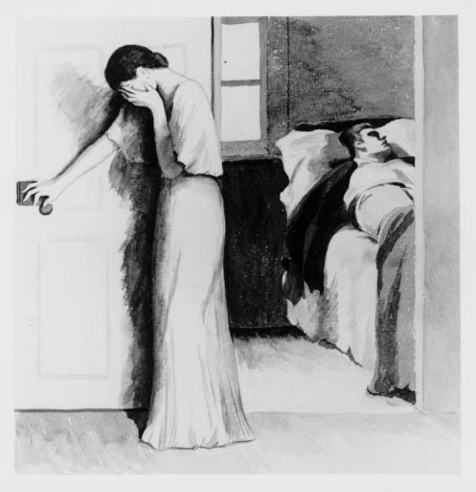

Slide 39
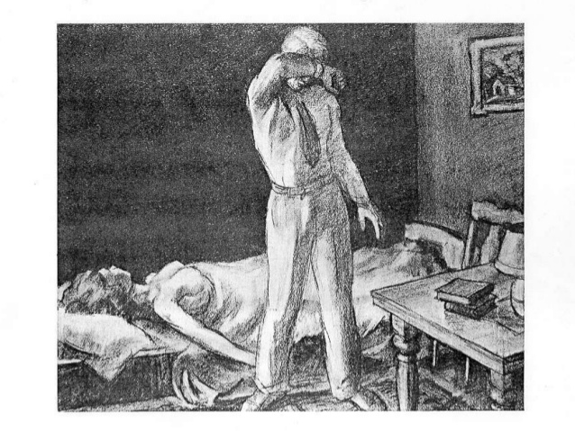

Slide 40
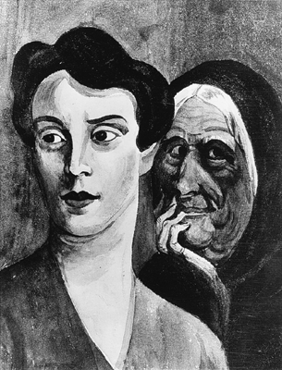

Slide 41
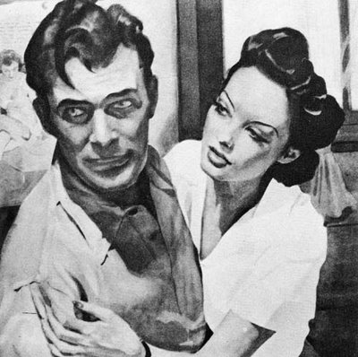

Slide 42
Children Apperception Test
Dr Leopold Bellak developed this test.
This projective technique presents situations of special concern to children. It consists of 10 animal pictures in a social context involving the child in conflict, identities, roles, family structures, and interpersonal interaction.

Slide 43
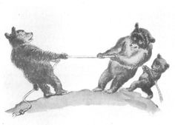

Slide 44
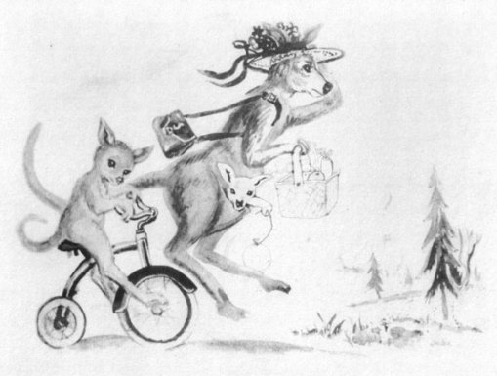

Slide 45
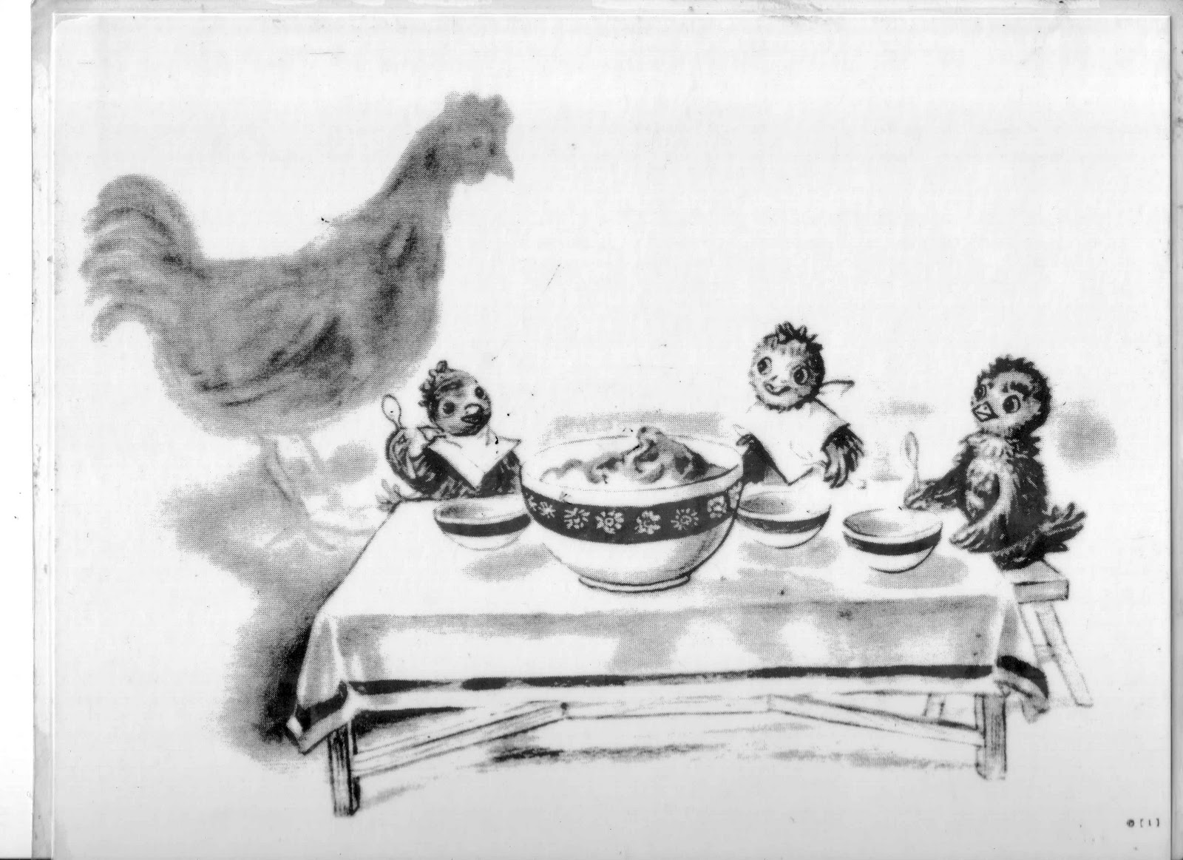

Slide 46
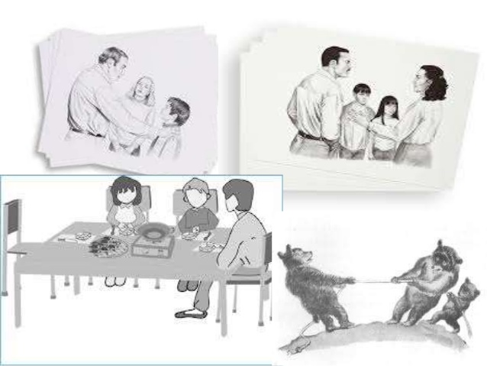

Slide 47
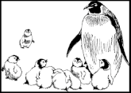

Slide 48
Draw a Person’s Figure Test
Developed originally by Florence Goodenough in 1926, this test was first known as the Goodenough Draw-a-Man test.
Originally developed as an intelligence test

Slide 49
Test administration involves the administrator requesting children to complete three individual drawings on separate pieces of paper.
Children are asked to draw a man, a woman, and themselves. No further instructions are given and the child is free to make the drawing in whichever way he/she would like.
There is no right or wrong type of drawing, although the child must make a drawing of a whole person each time — i.e. head to feet, not just the face.

Slide 50
